Slide 1
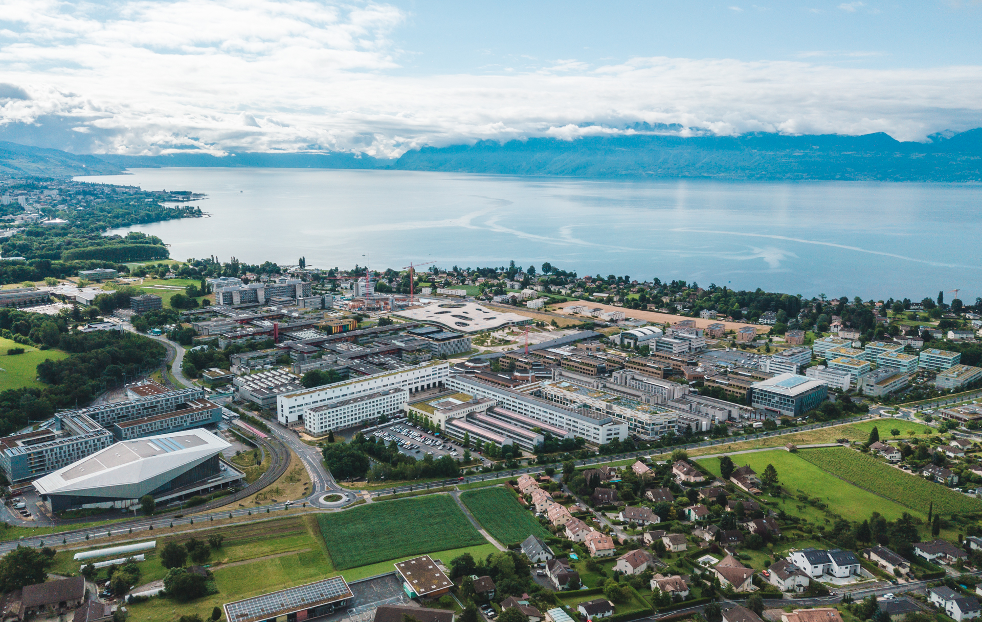
Meeting week 5
Guillaume Krafft
March 2023

Slide 2
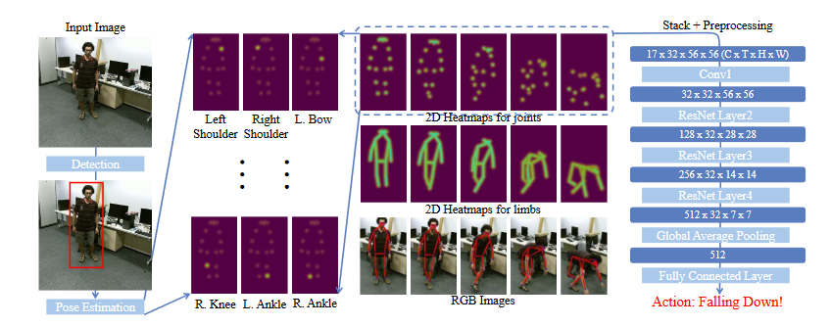
Vision – Skeleton based Action Recognition
Can retrieve keypoints using OpenPifPaf
Then find a way of using multiple keypoints map -> spatio-temporal
How ?
Using Graph Convolutional Networks
Using stacked heatmaps and a convolutional neural network (PoseConv3D)

Slide 3
Vision – Skeleton based Action Recognition
Datasets ?
A1: drink water | A2: eat meal | A3: brush teeth | A4: brush hair
A5: drop | A6: pick up | A7: throw | A8: sit down
A9: stand up | A10: clapping | A11: reading | A12: writing
A13: tear up paper | A14: put on jacket | A15: take off jacket | A16: put on a shoe
A17: take off a shoe | A18: put on glasses | A19: take off glasses | A20: put on a hat/cap
A21: take off a hat/cap | A22: cheer up | A23: hand waving | A24: kicking something
A25: reach into pocket | A26: hopping | A27: jump up | A28: phone call
A29: play with phone/tablet | A30: type on a keyboard | A31: point to something | A32: taking a selfie
A33: check time (from watch) | A34: rub two hands | A35: nod head/bow | A36: shake head
A37: wipe face | A38: salute | A39: put palms together | A40: cross hands in front
A61: put on headphone | A62: take off headphone | A63: shoot at basket | A64: bounce ball
A65: tennis bat swing | A66: juggle table tennis ball | A67: hush | A68: flick hair
A69: thumb up | A70: thumb down | A71: make OK sign | A72: make victory sign
A73: staple book | A74: counting money | A75: cutting nails | A76: cutting paper
A77: snap fingers | A78: open bottle | A79: sniff/smell | A80: squat down
A81: toss a coin | A82: fold paper | A83: ball up paper | A84: play magic cube
A85: apply cream on face | A86: apply cream on hand | A87: put on bag | A88: take off bag
A89: put object into bag | A90: take object out of bag | A91: open a box | A92: move heavy objects
A93: shake fist | A94: throw up cap/hat | A95: capitulate | A96: cross arms
A97: arm circles | A98: arm swings | A99: run on the spot | A100: butt kicks
A101: cross toe touch | A102: side kick | - | -
NTU RGB+D
Custom ?
Notes:
https://rose1.ntu.edu.sg/dataset/actionRecognition/

Slide 4
Audio
No significant update since last week
Issues with cross-correlation not generalizing to noisier inputs ☹

